Slide 1
Classification of living things
khalid al manthri

Slide 2
Animals
Arthropods
Vertebrates
Click the classification you want to go to the slide

Slide 3
Arthropods
insects
Arachnids
Myriapods
Crustacea
Back to animals

Slide 4
vertebrates
Fish
Amphibia
Reptiles
Birds
Mammals
Back to animals

Slide 5
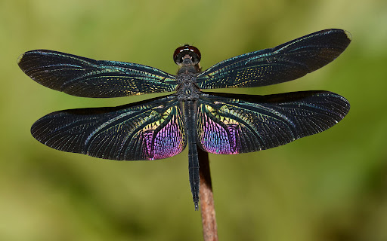
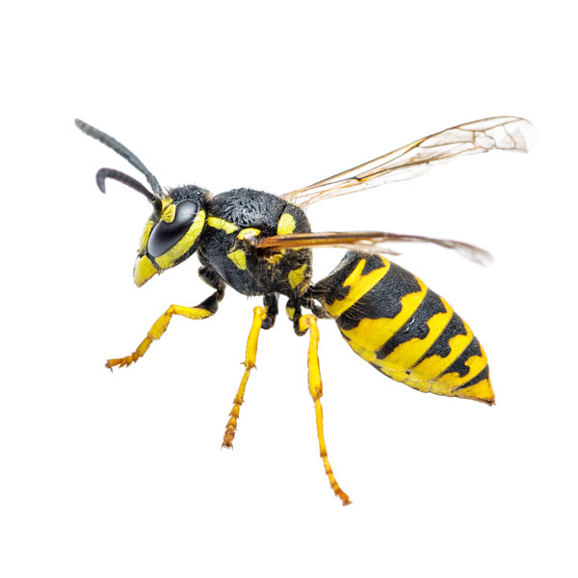
insects
Pairs of legs: 3
Body divided into head, thorax, abdomen
Pairs of antennae: 1
One pair of compound eyes
dragonfly
Usually have 2 pairs of wings
Back to animals
Back to arthropods
wasp

Slide 6
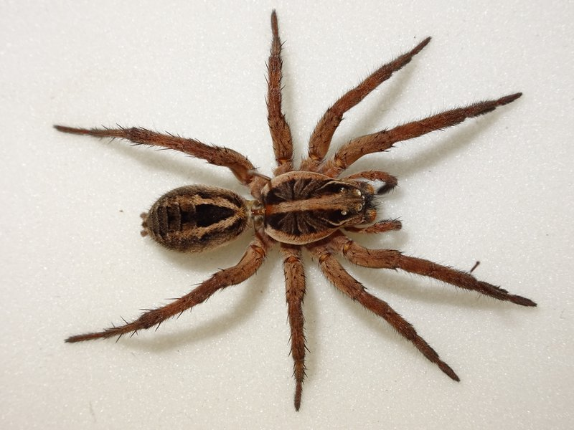
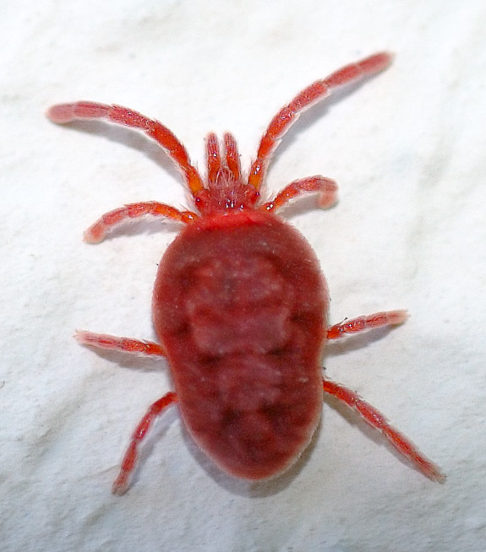
Arachnids
Pairs of legs: 4
Body divided into cephalothorax, abdomen
No antennae
Several pairs of eyes
spider
Chelicerae (fangs) to poison and paralyze prey
Back to animals
Back to arthropods
mite

Slide 7
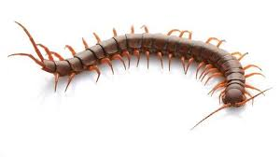
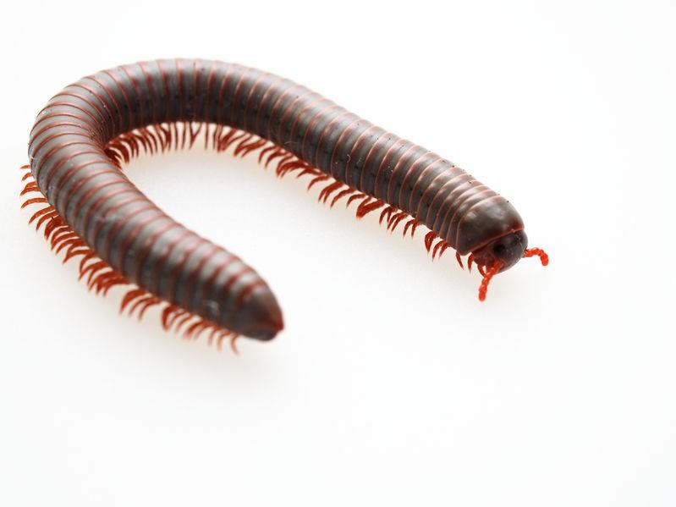
Myriapods
Pairs of legs: 10 or more
Body divided into thorax and abdomen
One pair of antennae
One pair of normal eyes
centipede
Back to animals
Back to arthropods
Millepede

Slide 8
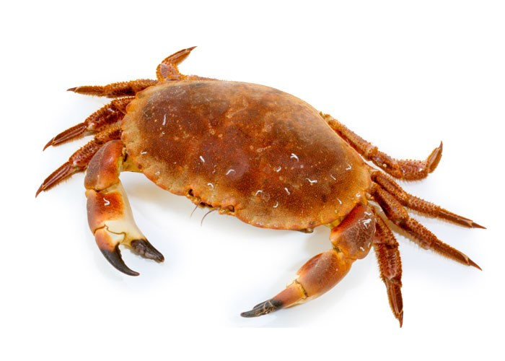
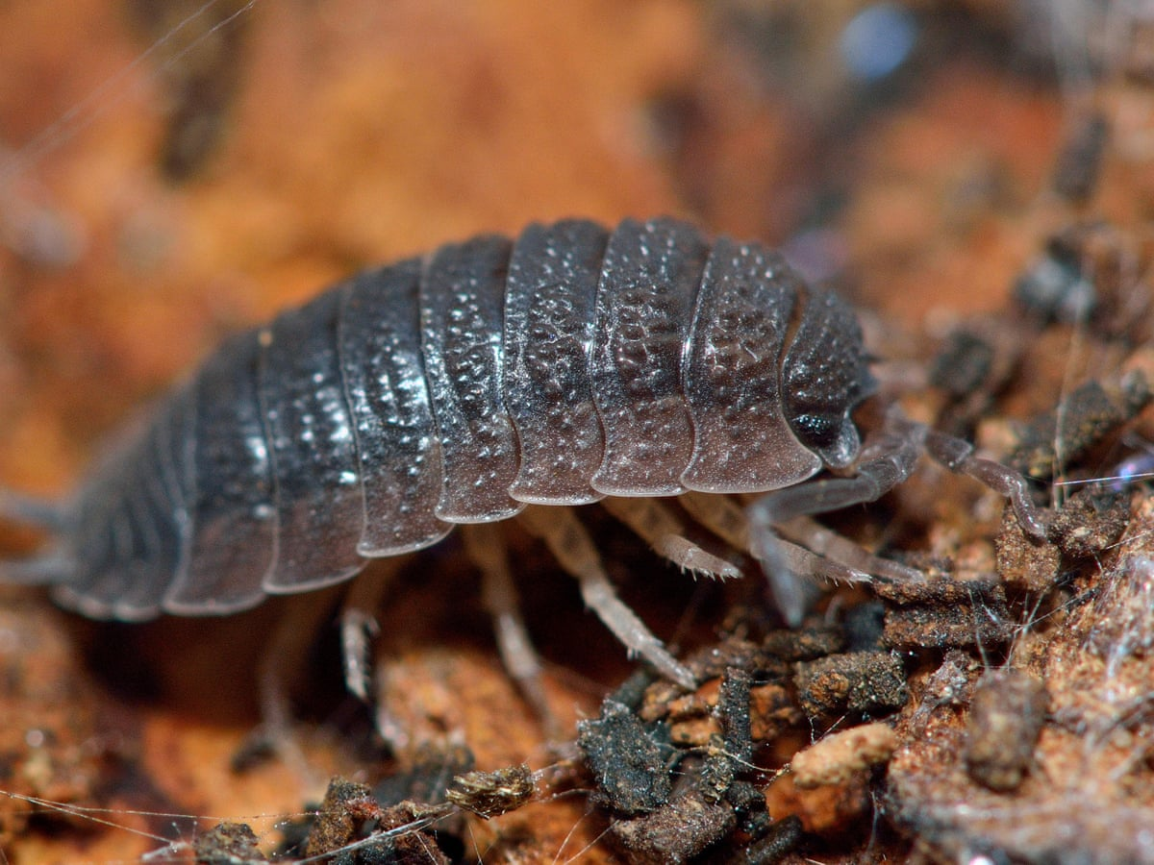
Crustacea
Pairs of legs: 5 or more
Body divided into cephalothorax and abdomen
two pairs of antennae
One pair of compound eyes
crab
Have hard exoskeleton
Back to animals
Back to arthropods
woodlouse

Slide 9
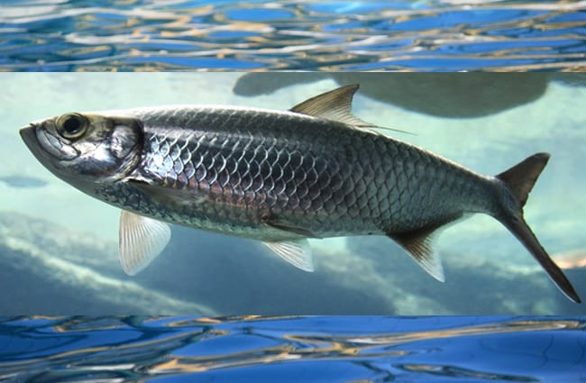
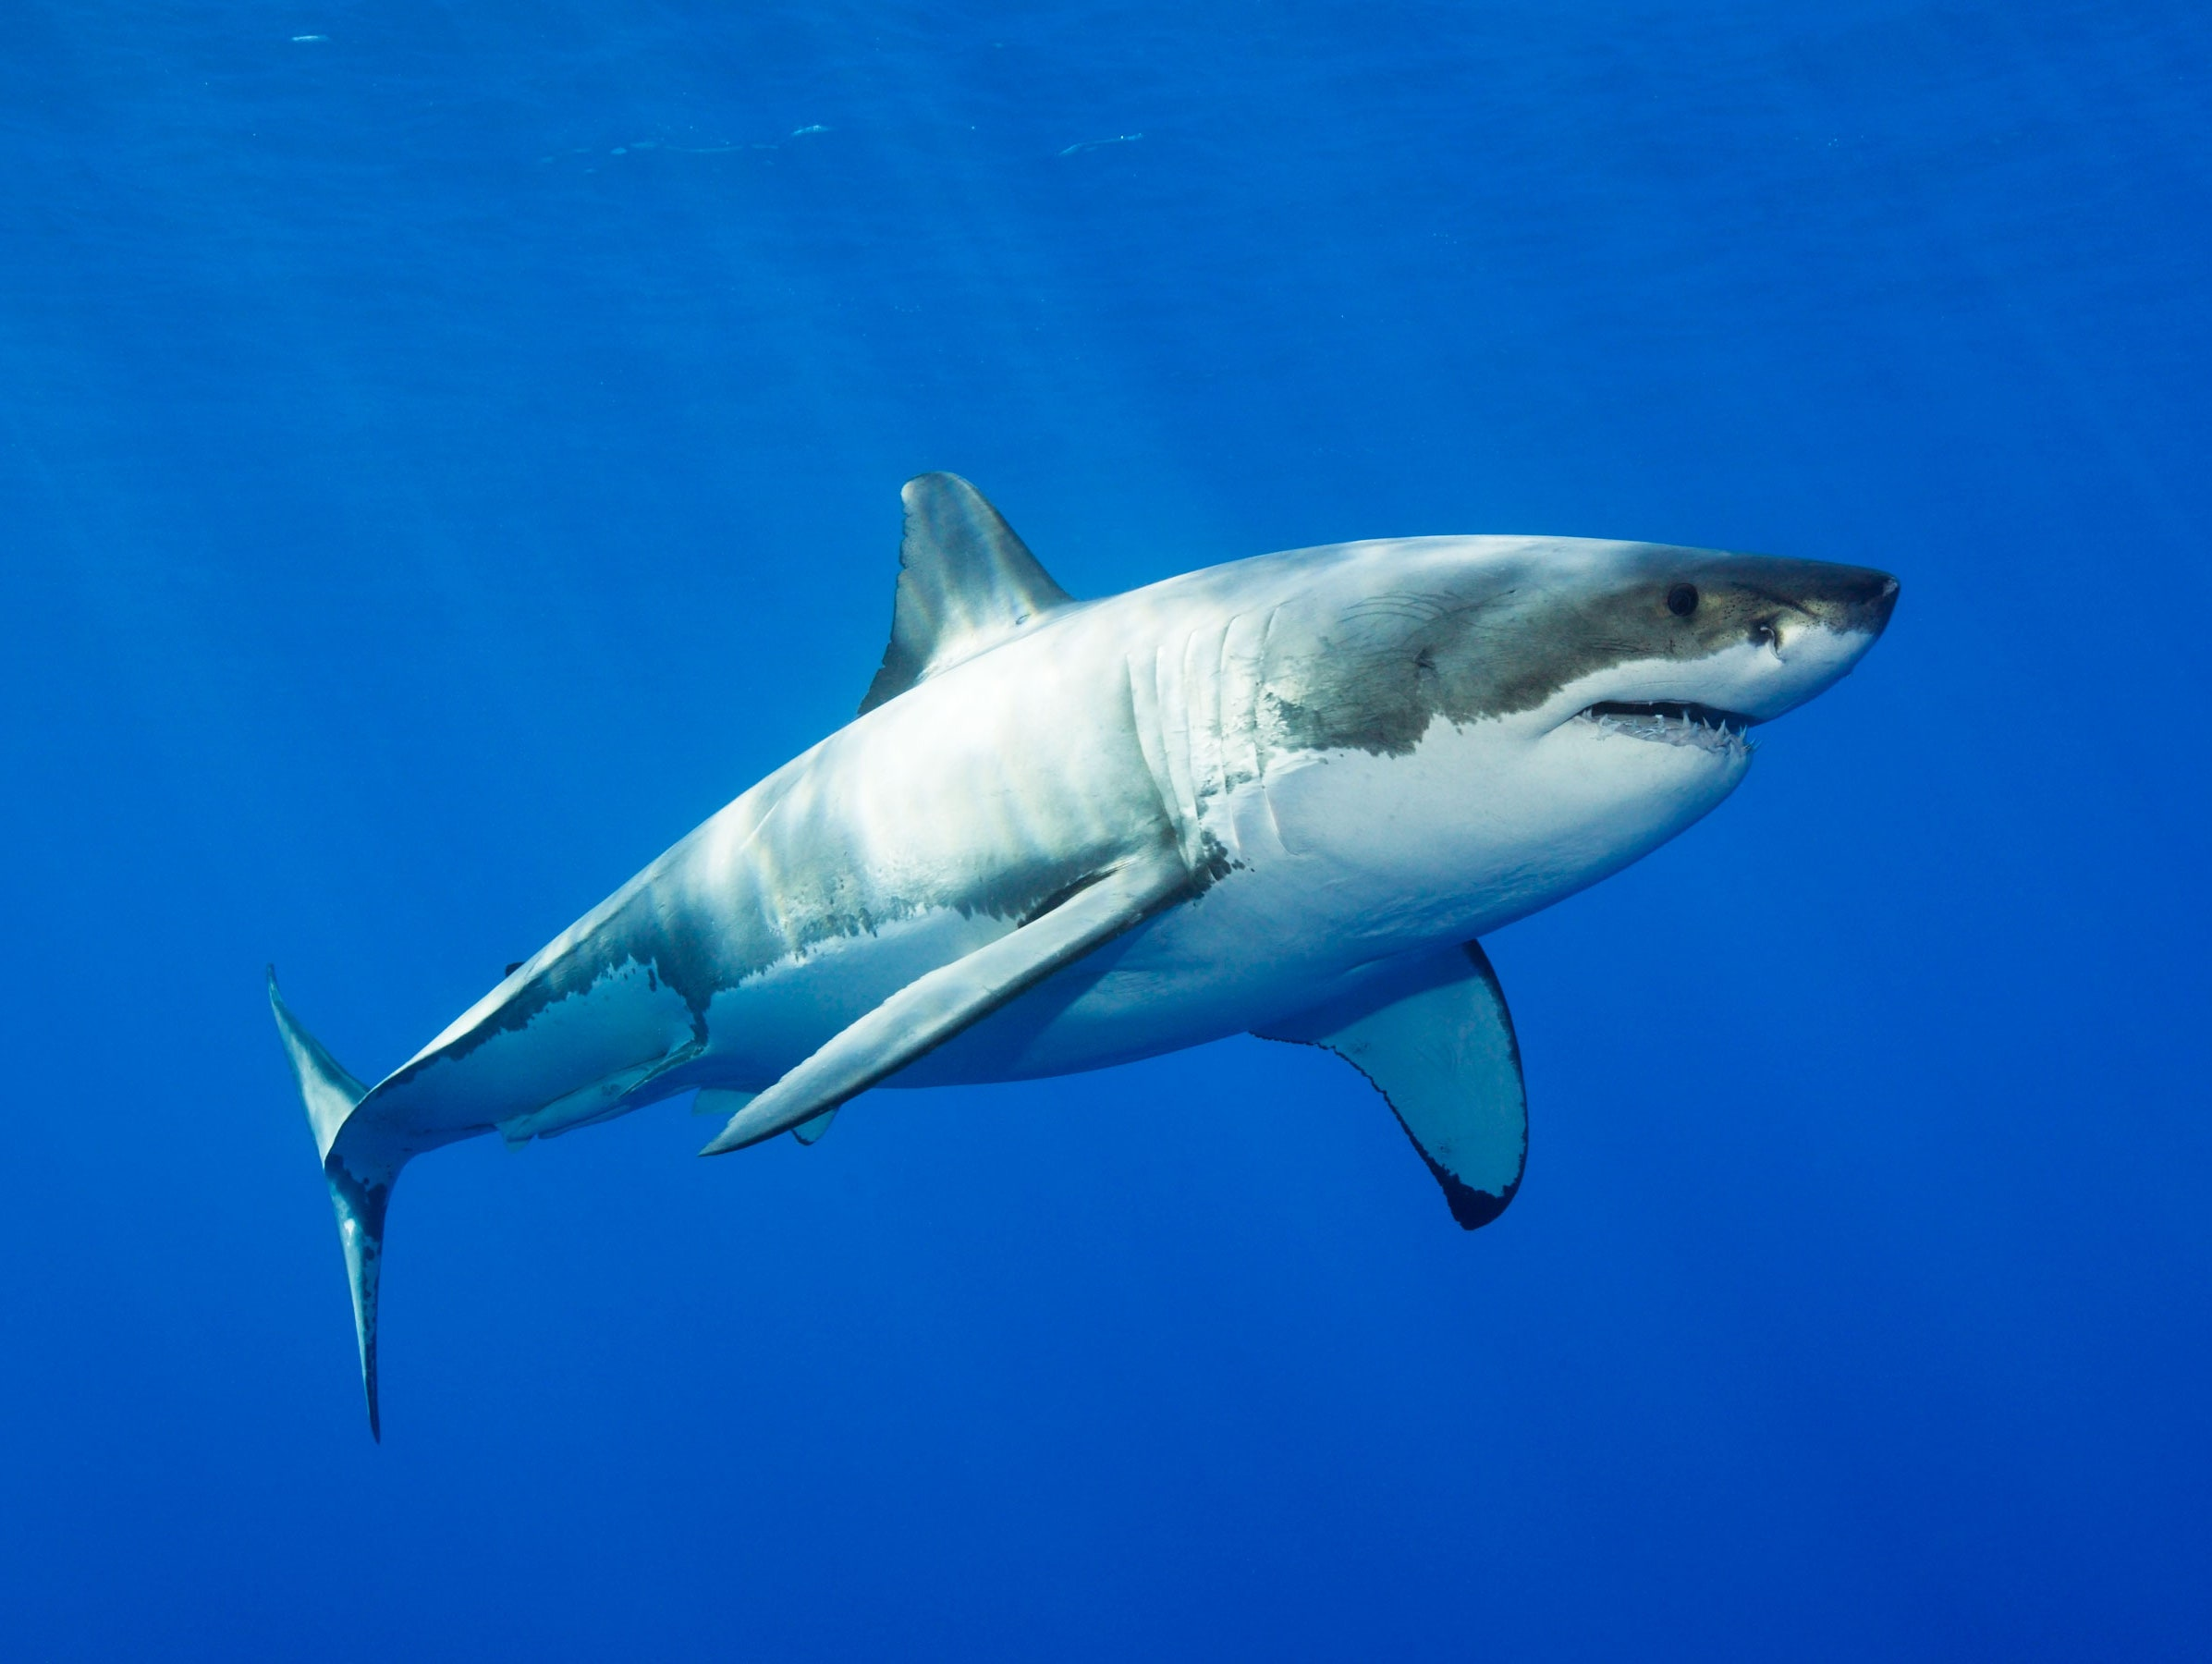
Fish
Body covered with scales
Move with fins
Reproduce by laying jelly-like eggs in the water
Cold blooded and breathe with gills
herring
Sense with eyes, and detect vibrations with lateral lines
shark
Back to animals
Back to vertebrates

Slide 10
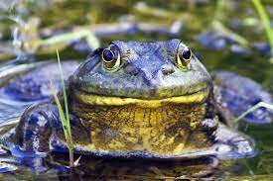
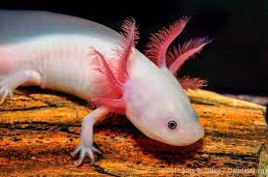
Amphibia
Moist skin
Four limbs, back feet are often webbed to help swim
Reproduce by laying jelly-like eggs in water
Frog
Cold blooded and breathe with lungs
salamander
Sense with eyes and ears
Back to animals
Back to vertebrates

Slide 11
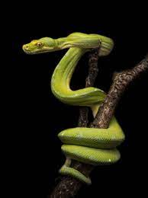
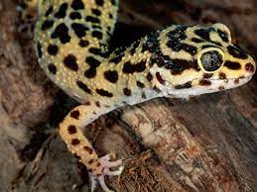
reptiles
Dry skin and have scales
Four legs except snakes
Reproduce by laying waterproof
rubber-like eggs in land
Cold blooded and breathe with lungs
gecko
Sense with eyes and ears
snake
Back to animals
Back to vertebrates

Slide 12
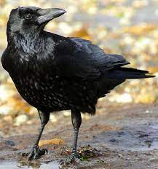
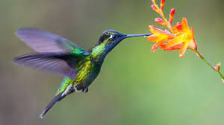
birds
Covered in feathers with scales on the legs
two legs, and two wings to fly
Reproduce by laying hard shells in the land
warm blooded and breathe with lungs
robin
hummingbird
Sense with eyes and ears
Back to animals
Back to vertebrates

Slide 13
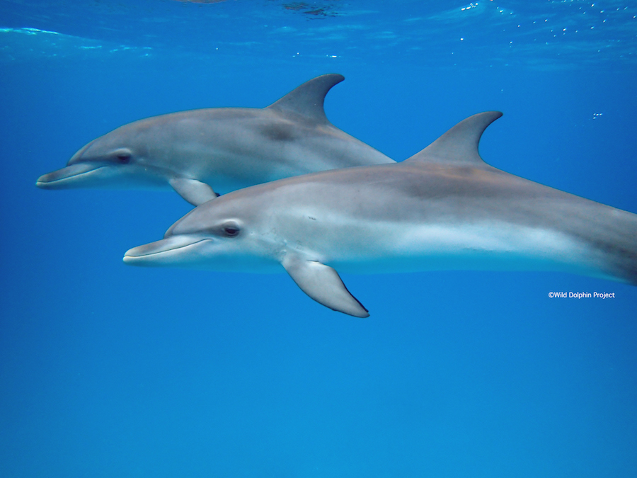
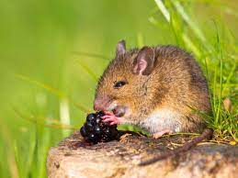
mammals
Skin covered in fur
Four limbs
Reproduce by giving birth to a fully formed young baby.
warm blooded and breathe with lungs
dolphin
Sense with eyes and ears
mouse
Back to animals
Back to vertebrates

